Slide 1
Projects

Slide 2


Slide 3
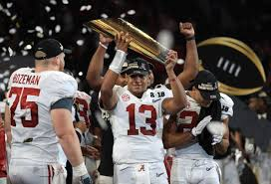

Slide 4
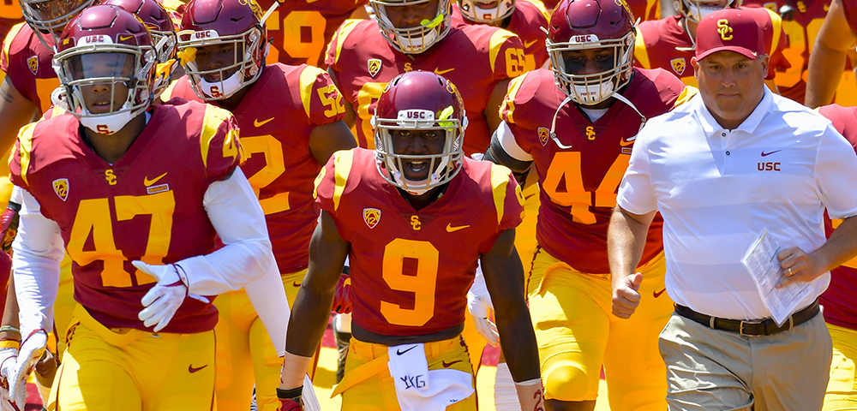

Slide 5
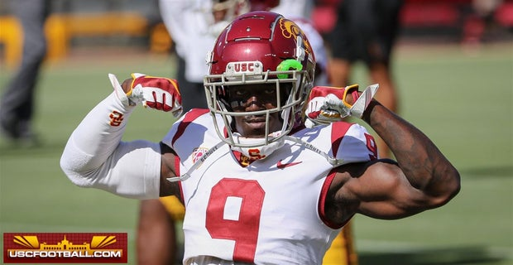

Slide 6


Slide 7
Can I predict who WON’T get drafted?

Slide 8
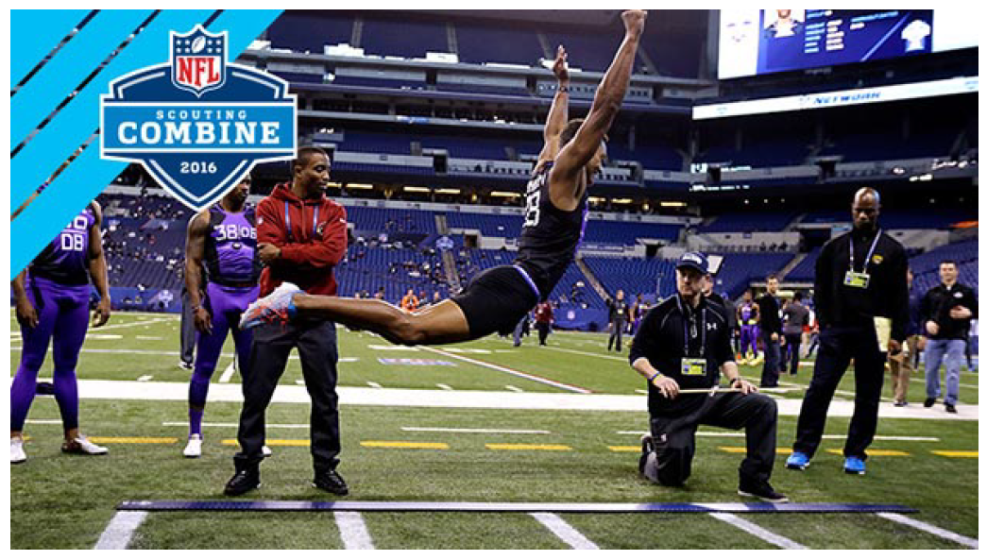

Slide 9
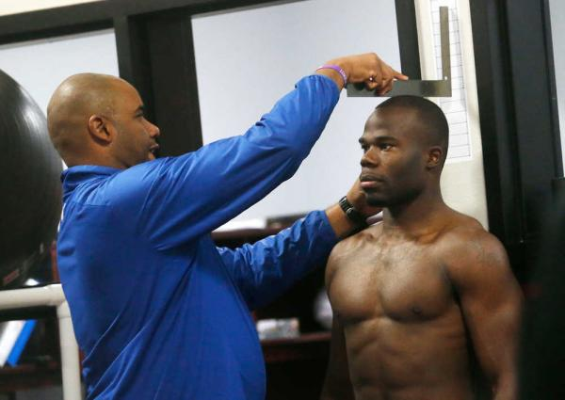

Slide 10
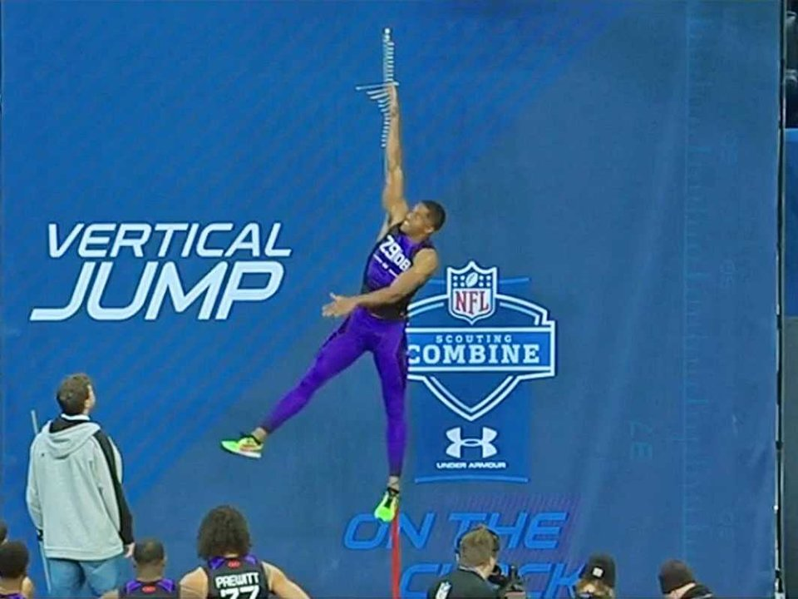

Slide 11
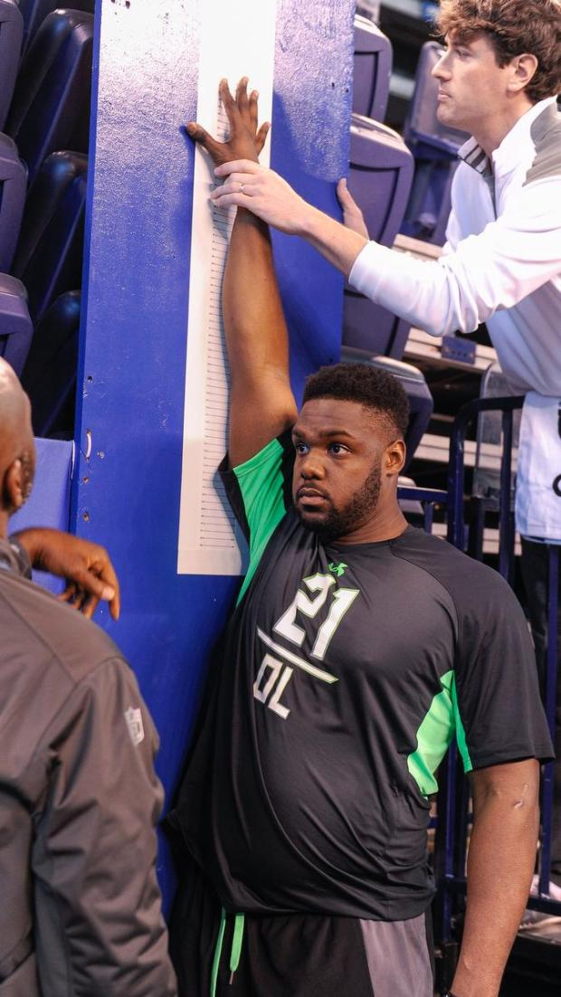

Slide 12
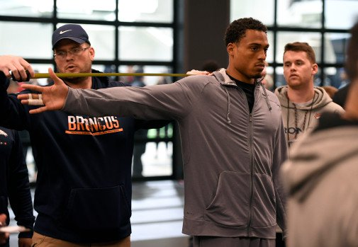

Slide 13
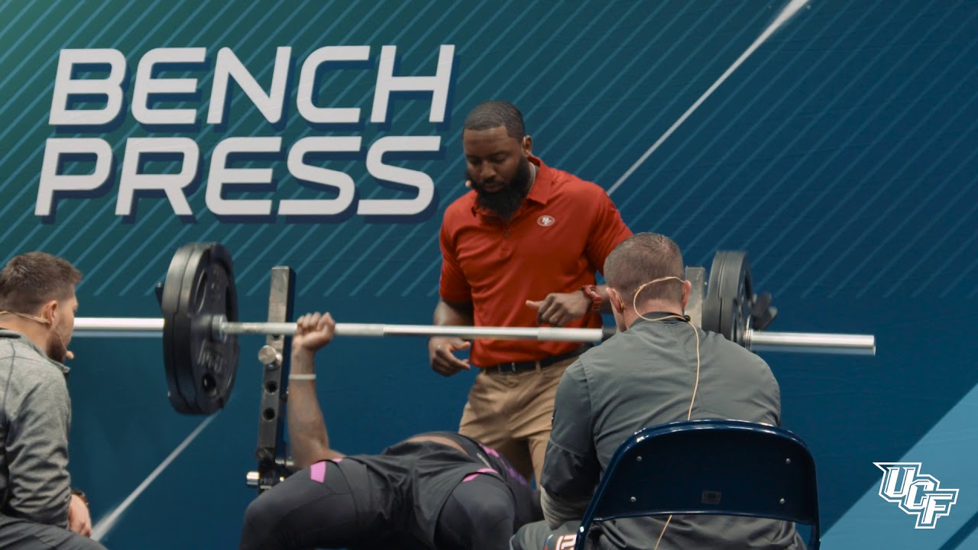

Slide 14
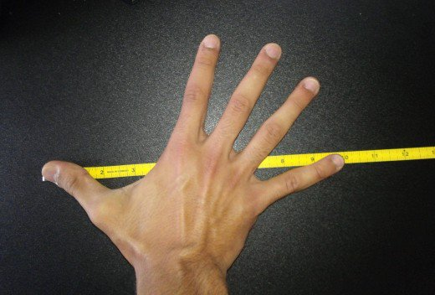

Slide 15
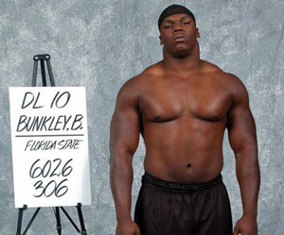

Slide 16
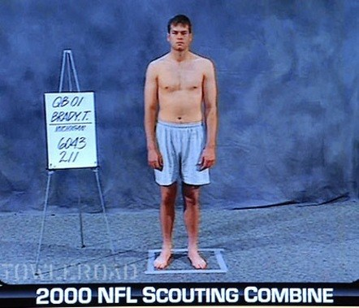

Slide 17
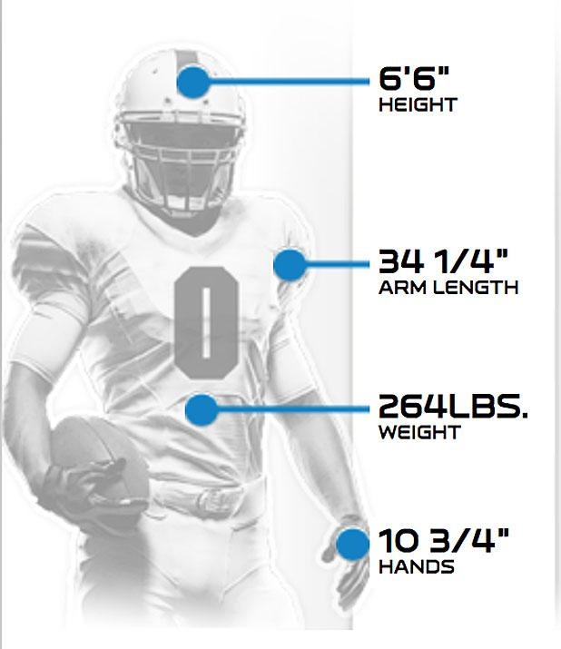

Slide 18
Wonderlic
NFL IQ Test

Slide 19
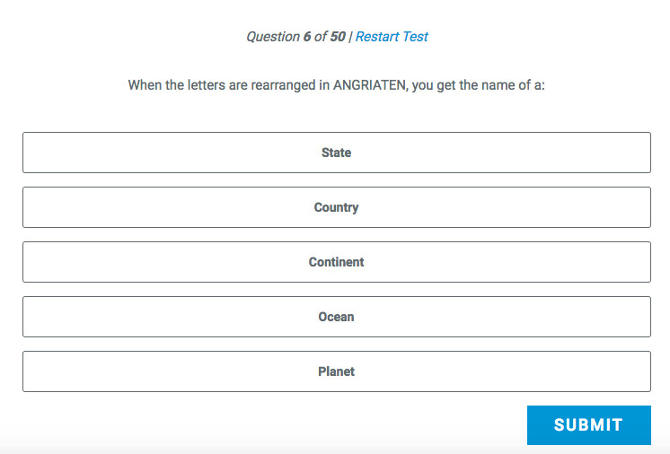

Slide 20
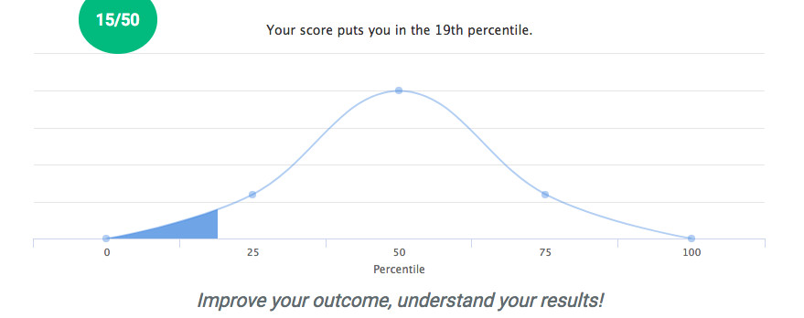

Slide 21
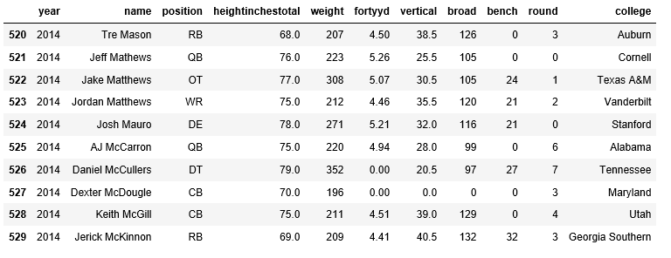

Slide 22
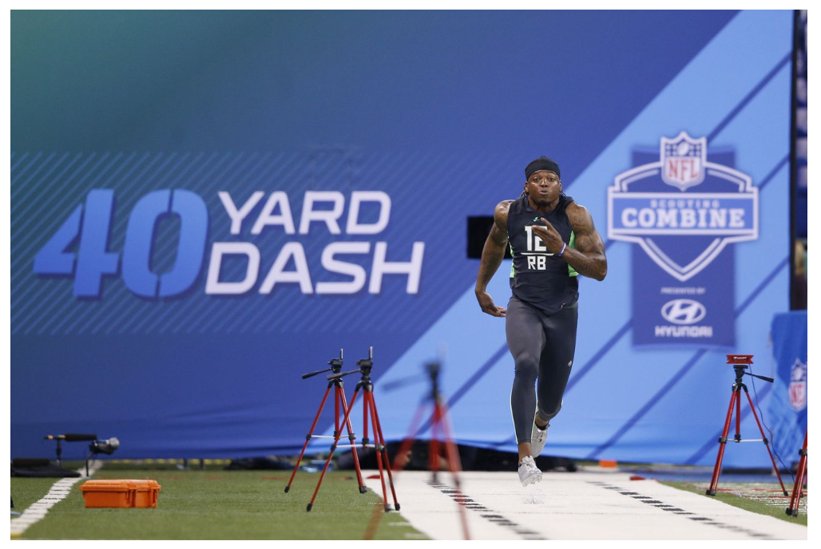

Slide 23
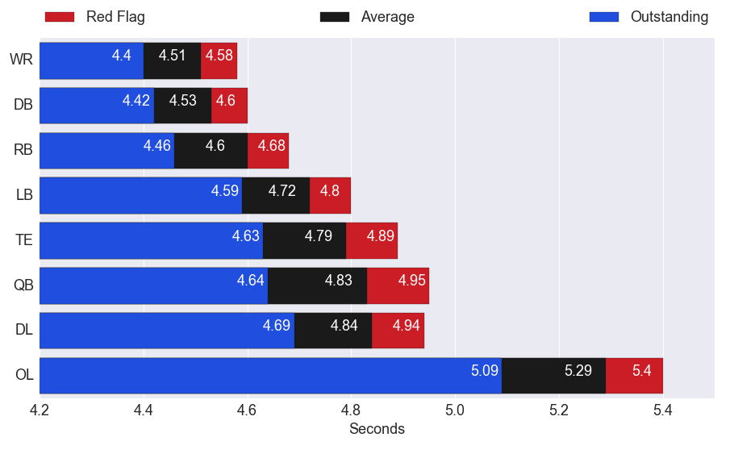

Slide 24
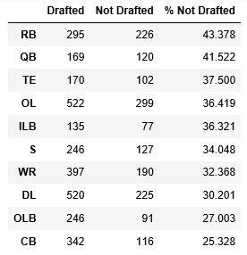

Slide 25
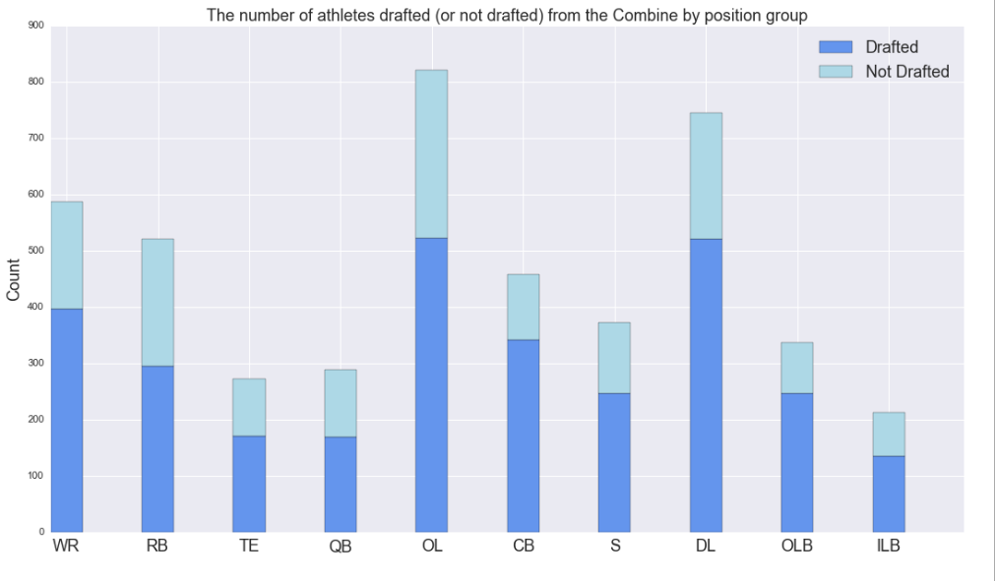

Slide 26













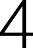









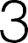












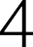



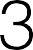
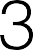

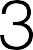


















Slide 27












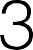










Slide 28
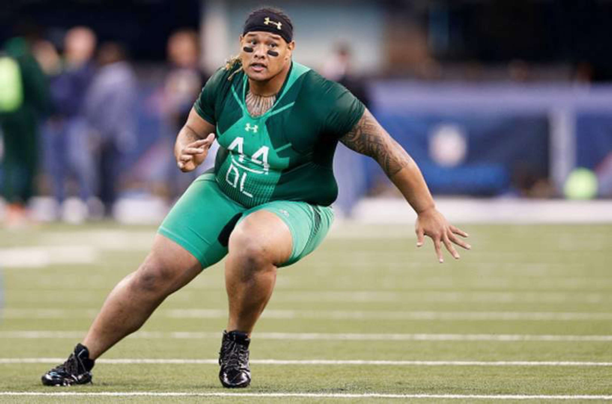

Slide 30
























Slide 31
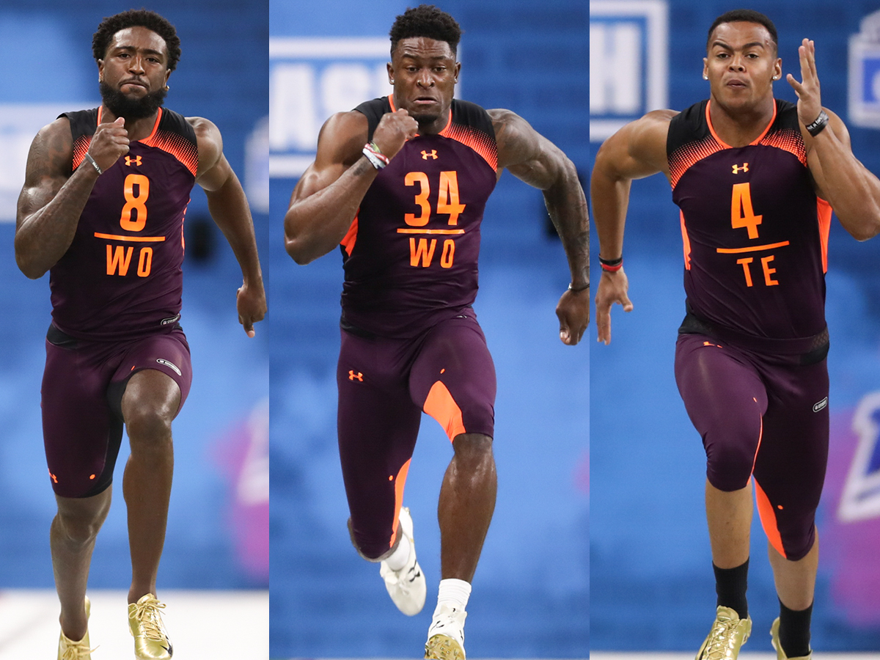
Identifying Outcomes
Undrafted
Drafted

Slide 32
Identifying Outcomes
Undrafted
Drafted
94%

Slide 33
Identifying Outcomes
Undrafted
Drafted
94%
80%

Slide 35
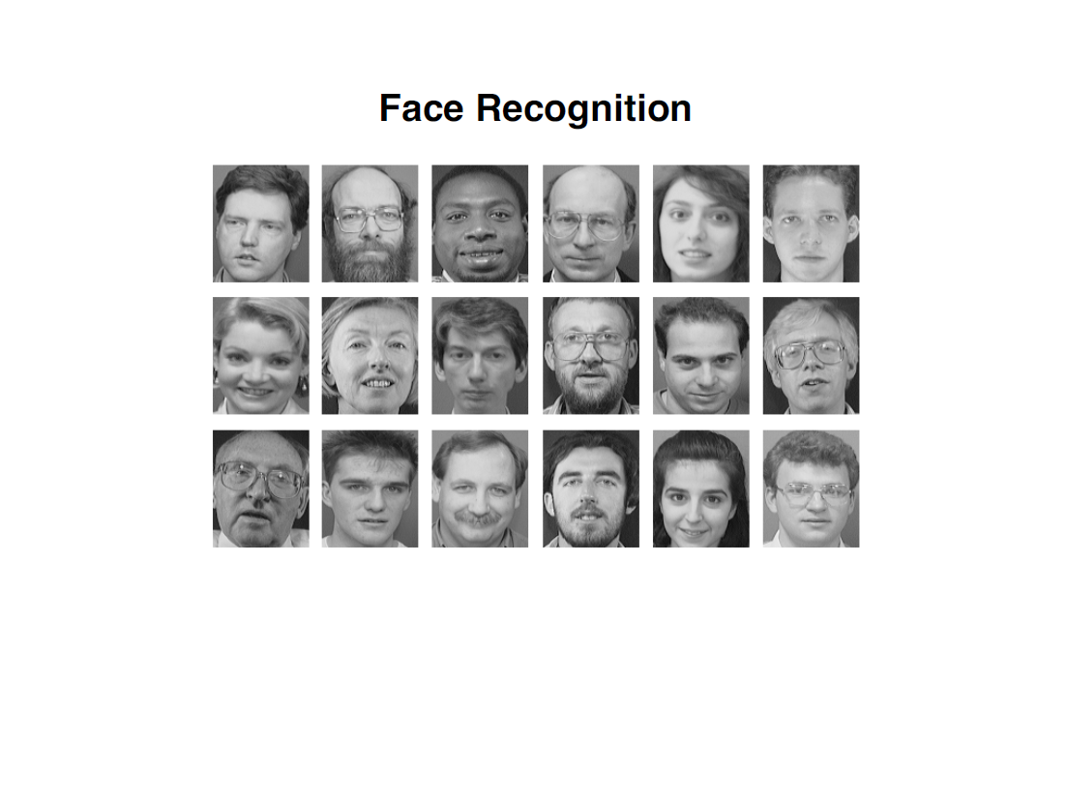

Slide 36
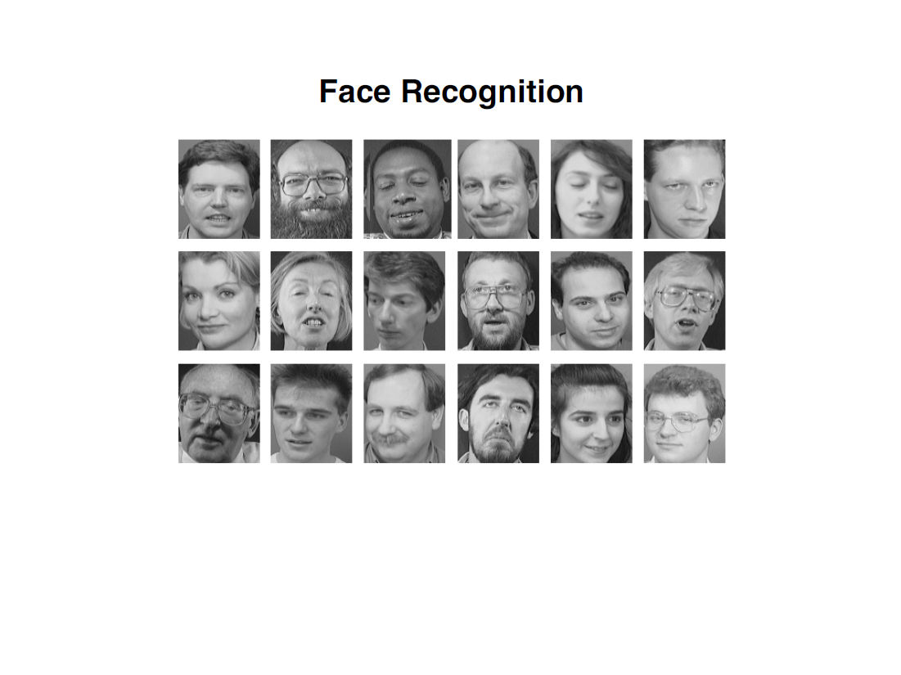

Slide 37
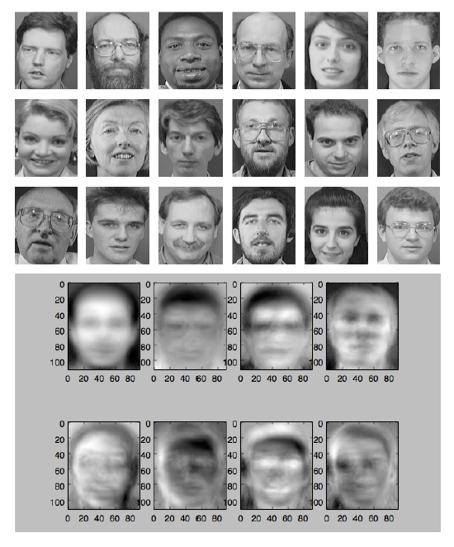

Slide 38
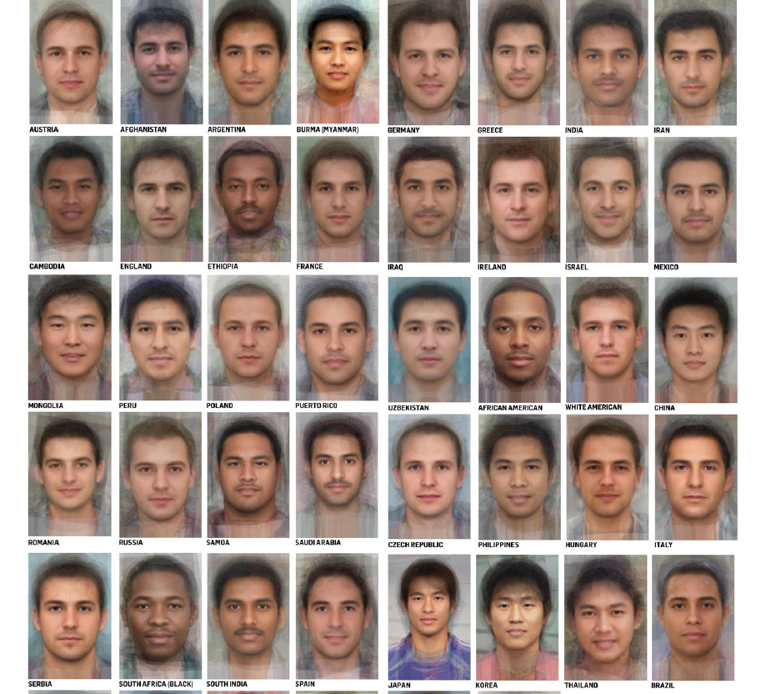

Slide 39
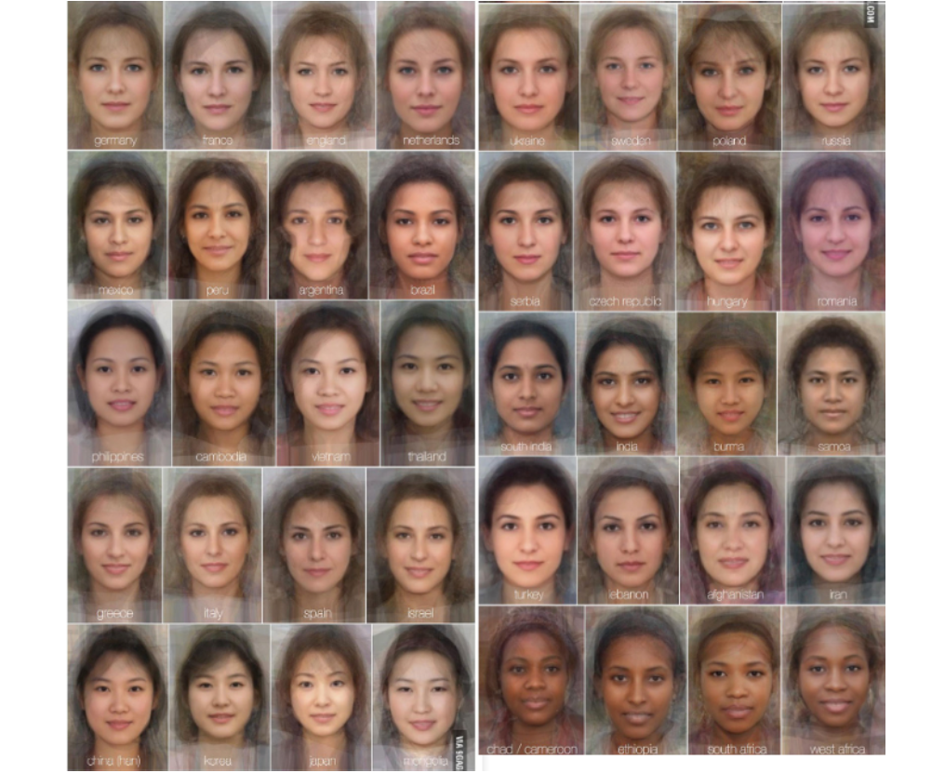

Slide 40
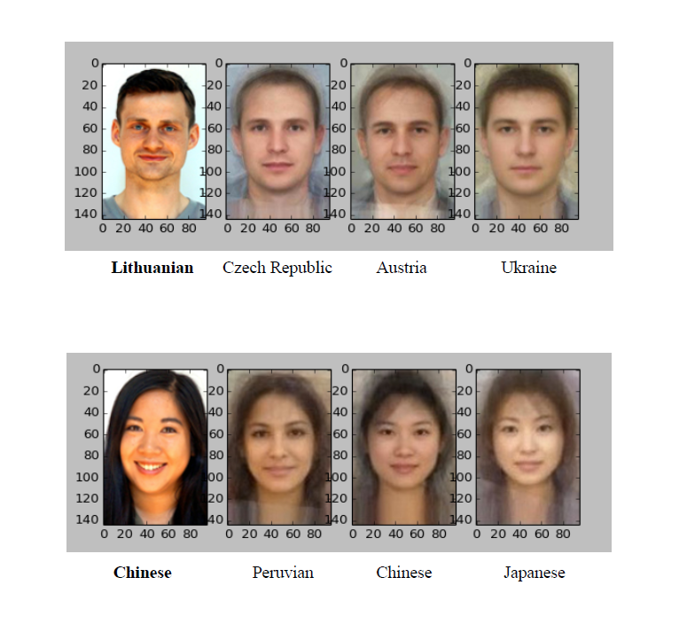

Slide 42
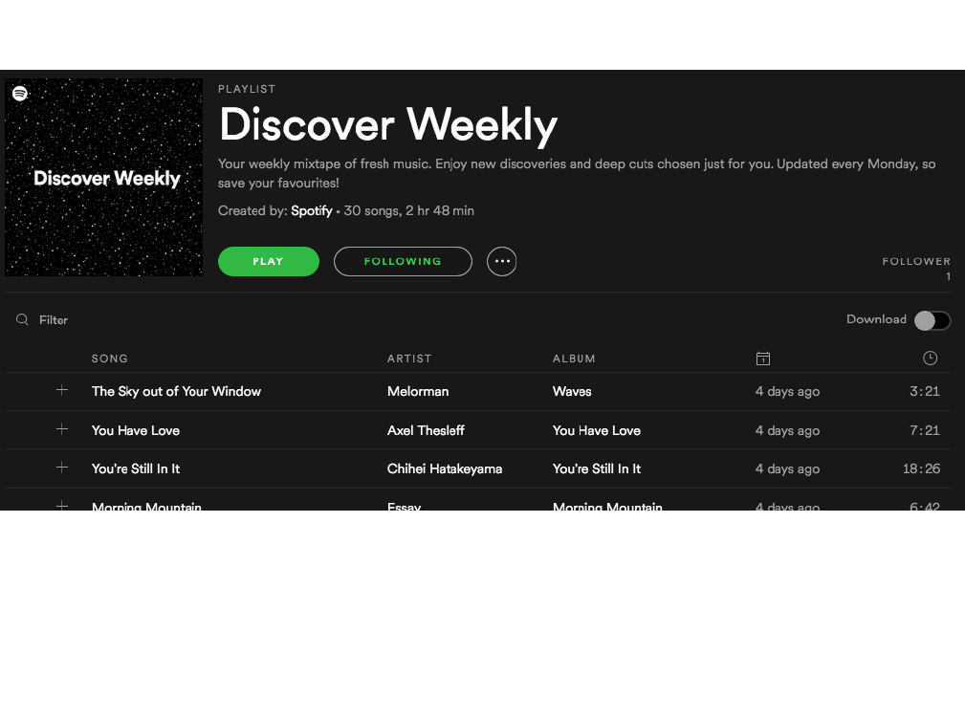

Slide 43
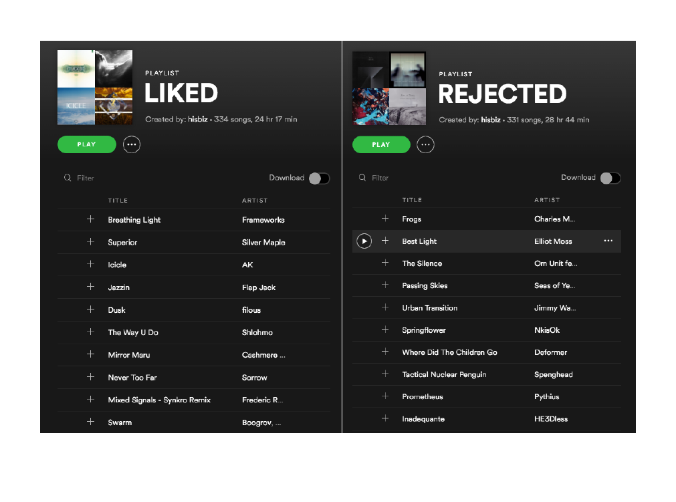

Slide 44


Slide 45
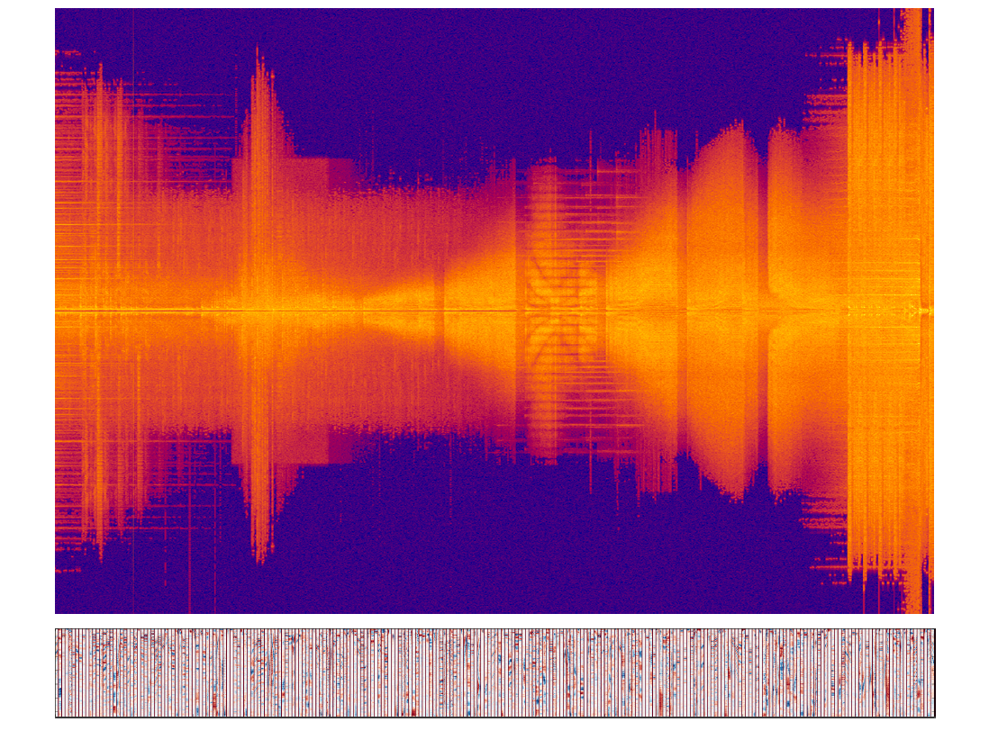

Slide 46
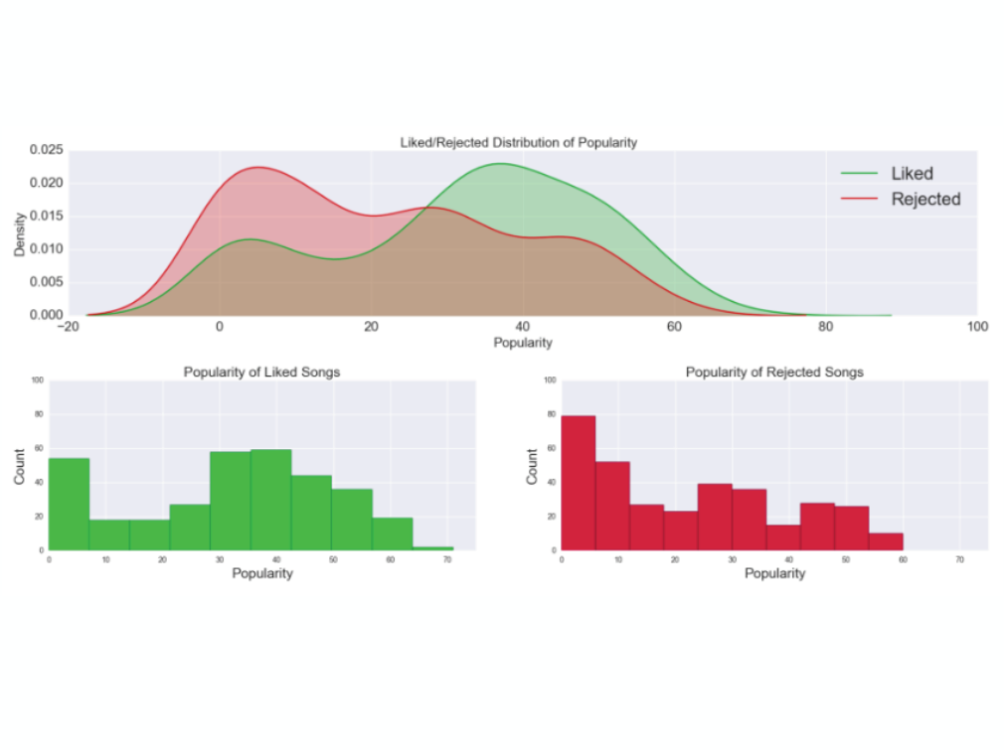

Slide 47
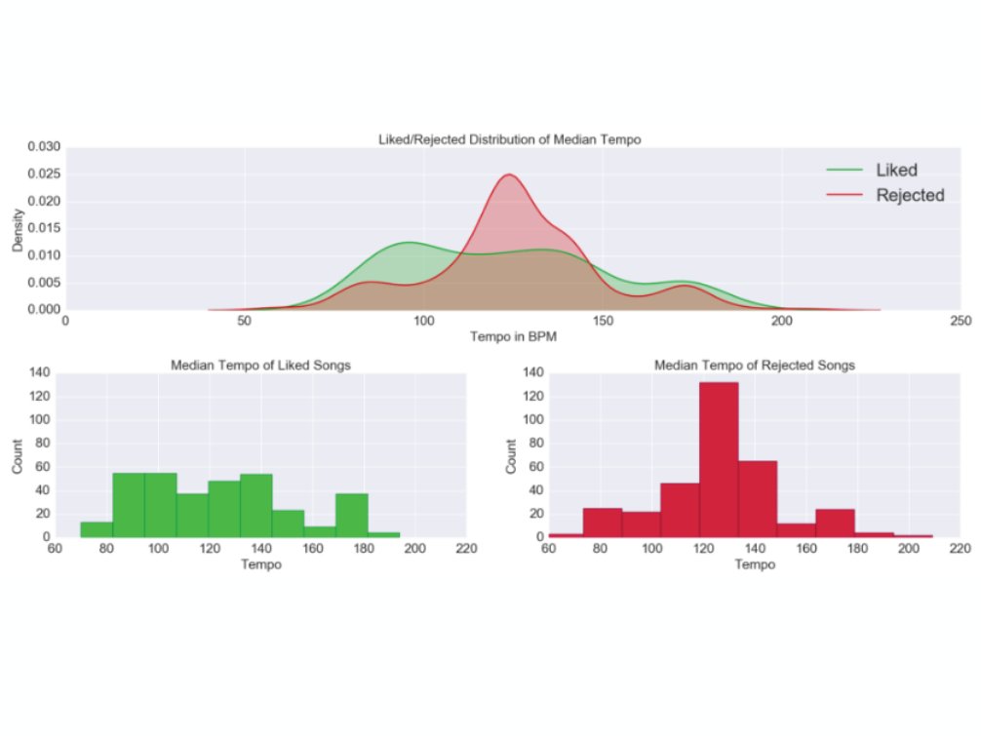

Slide 48
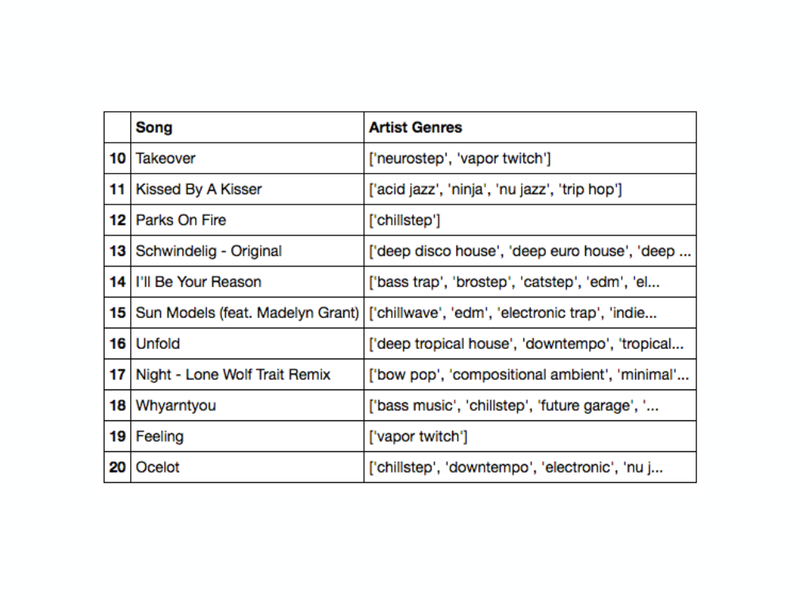

Slide 49
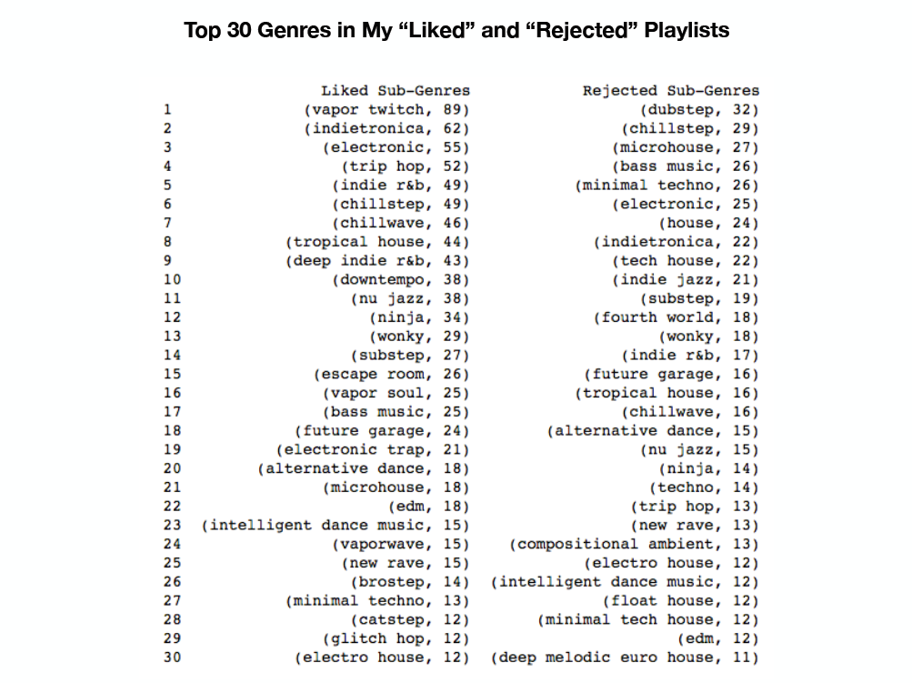

Slide 54
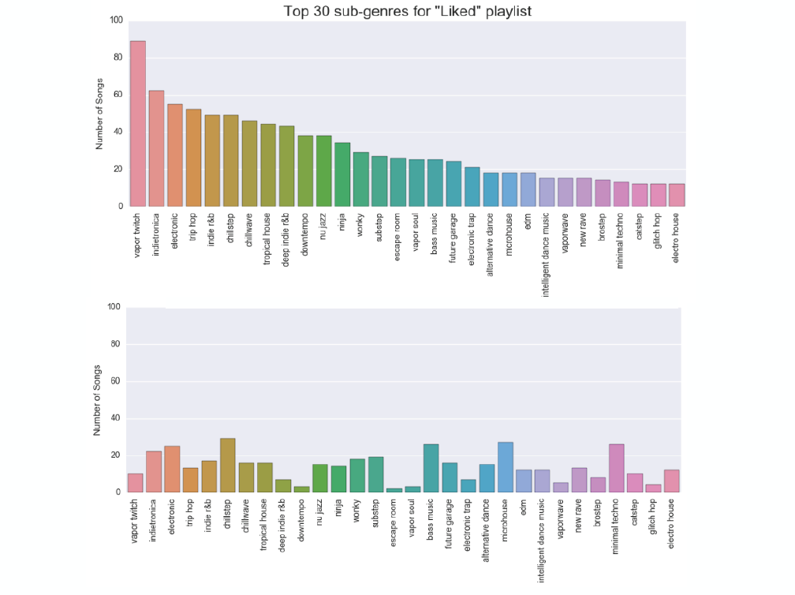

Slide 55














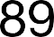
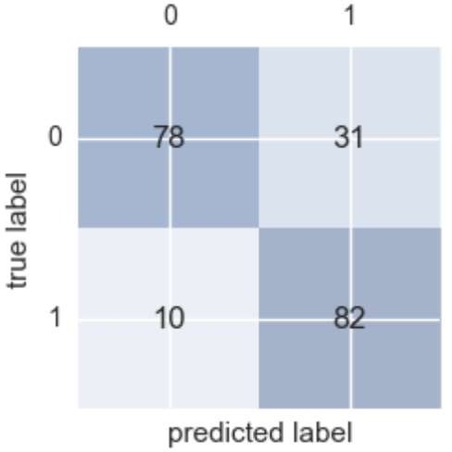

Slide 58
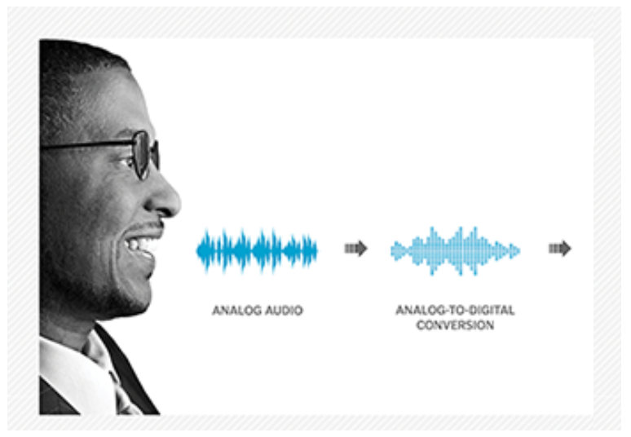
Recognizing Race by Voice

Slide 60

“Apple became the first U.S. company to surpass
$1 trillion in market value.”
- Wall Street Journal, August 2, 2018

Slide 61

Tech companies are amassing wealth and
power, creating a new order in business where the most valuable resource is no longer oil, but
data.
- Wall Street Journal, September 5, 2018

Slide 62
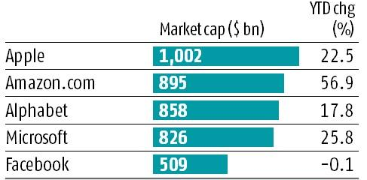
Top 5 Companies in the World

Slide 63
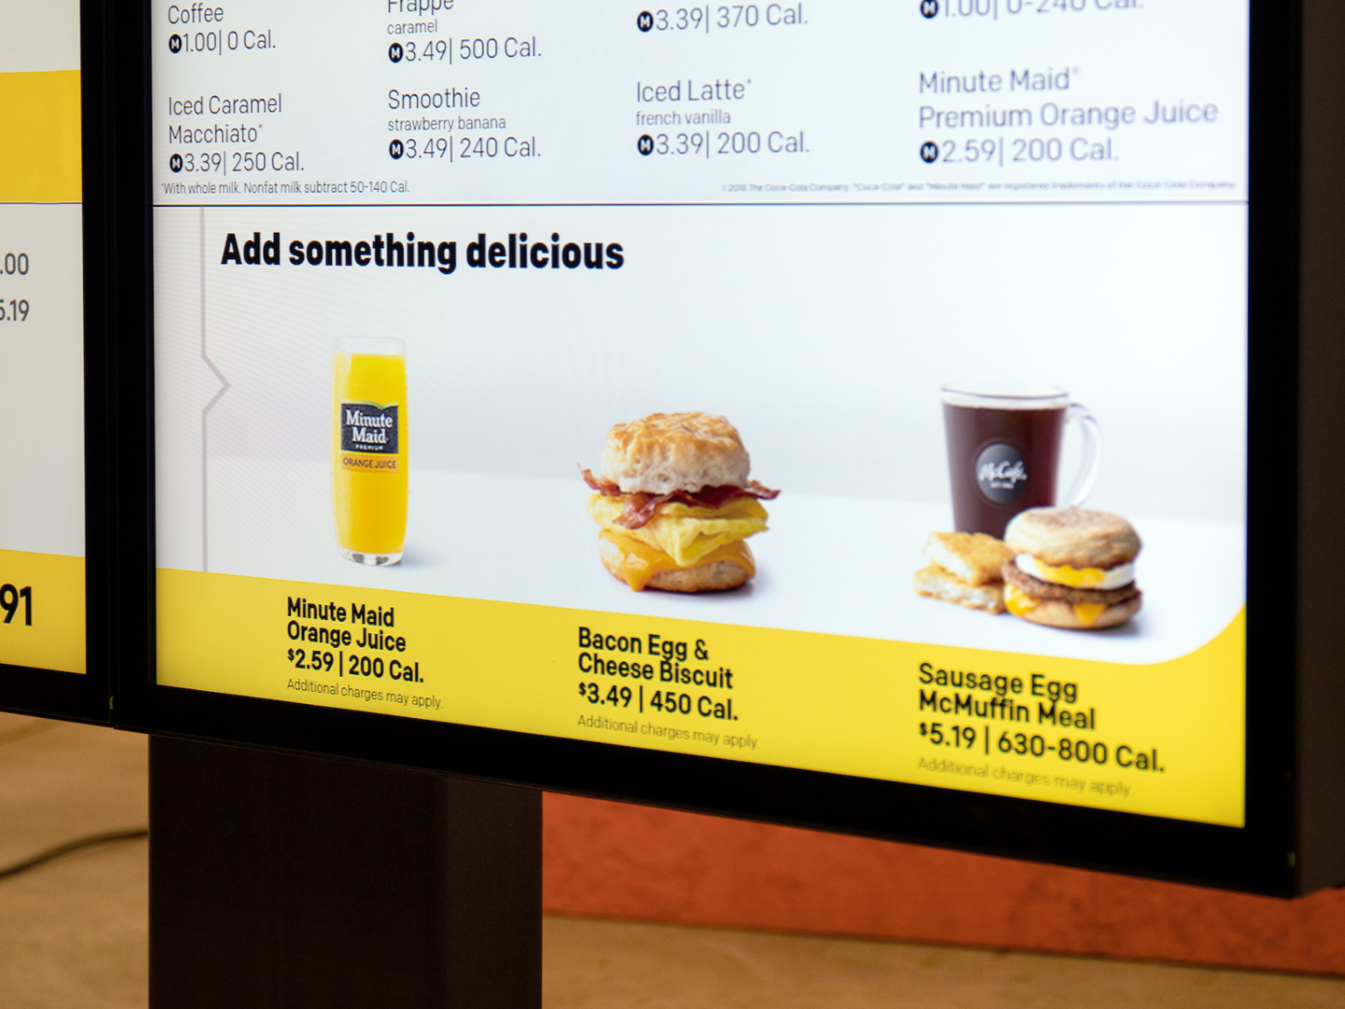
“We’re expanding our ability to increase the role technology and data will play in our future and create more personalized experiences for our customers.”
March 25, 2019
Steve Easterbrook, McDonald’s CEO

Slide 65
Next steps
Make a custom plan for yourself to continue this journey
Improve some of your skills (Stats, Python, ML, Domain, etc.)
Take some additional courses
Try a Kaggle.com competition
Work on a personal project to improve understanding and motivate your learning

Slide 66
Useful Data Science and Machine Learning books for beginners to intermediate:
Book | Author
Data Smart: Using Data Science to Transform Information Into Insight | John W. Foreman
Naked Statistics: Stripping the Dread from the Data | Charles Wheelan
An Introduction to Statistical Learning | Robert Tibshirani and Trevor Hastie
Python Machine Learning | Sebastian Raschka and Vahid Mirjalili
The Hundred-Page Machine Learning Book | Andriy Burkov

Slide 67
Predictive Value
Undrafted
Drafted

Slide 68
Predictive Value
Undrafted
Drafted
69%

Slide 69
Predictive Value
Undrafted
Drafted
69%
97%

Slide 70
Conclusion

Slide 71
